Slide 1
Redbubble.com
Data analytics approach
By Dipam Sarkar

Slide 2
Agenda
About the Data & Insights Overview
Steps Involved In Project
Factor Influencing In Online E-Commerce Industry
Primary Objectives
Data Exploration & Finding Insights
Recommendations
Conclusion

Slide 3
About the Data & Insights Overview
Redbubble is an American e-commerce company focused on handmade or vintage items and craft supplies. These items fall under a wide range of categories, including toys, art, Soft toys as well as craft supplies,posters,Stickers and tools. It Was founded 16 Years back in 2005.My Datasets evolve around 6 number of table and more then 1 lakhs rows in each table & each table has more then 4 attributes and I took just 4 of their newly launch products from the year 2012-2016.My Main Analytical Approach in this dataset is to find online website analysis and finding insights for online Business. Listed below some of my finding insights list
1.Webiste traffic Analysis.
2.Bid Optimization for Utm Sources.
3.Landing Page Analysis.
4.Product Sales Analysis.
5.User Behavior Analysis.
6.Conversion Rate Analysis.

Slide 4
Steps Involved In Project
Importing Dataset-I have Imported the dataset from online maven analytics e learning portal. It was in CSV for mat with 8 tables and more then 1 lakhs for each table.
Data Processing and Cleaning-The next step was to clean data and processing in SQL.For Data Cleaning Purpose I Have Used some DML & DDl Statements like Text Funtions,Coalesce,Str_to_date,Distinct,Update,TrunCate,Case when Etc.
Data Exploration & Finding Insights-Finally Mysql is used to gain business insights from large datasets & Solve Problems.For Visualizations Purpose I used Excel(2016).

Slide 5
Factor Influencing In Online E-Commerce Industry
1.Website Landing Pages
2.Conversion Rate understanding for Each Page
3.UTM Source Understanding
4.Growth Rate By Device Type
5.Understanding Brand Vs Nonbrand Analysis
6.Refund Rate Analysis
7.Click Rate Conversion Analysis

Slide 6
Primary Objectives
There are ample amount of objective we can find from this dataset but our main concern is to help business problems,growth and also help business official website to grow its performance from datasets.
1.Product level sales analysis is the most important thing for any kind of business from this we can find that which product is makes largest profit and which makes less amount of profit.
2. Product Level Refund Analysis can give us which Product and amount rejected by customers so that business can optimize their products.
3.Website Landing page Analysis is also very useful objectives, from this analysis business can analyze their website landing page understanding and what are modification required to accrue more customers.
4.Business Seasonality Analysis helps business to understand which month or quarter of the year which product is in trending position and which month business face loss margin.
5.Another important analysis for any ecommerce company is conversion rate analysis, from this analysis business can understand their conversion by each step of any product purchase for each customer.

Slide 7
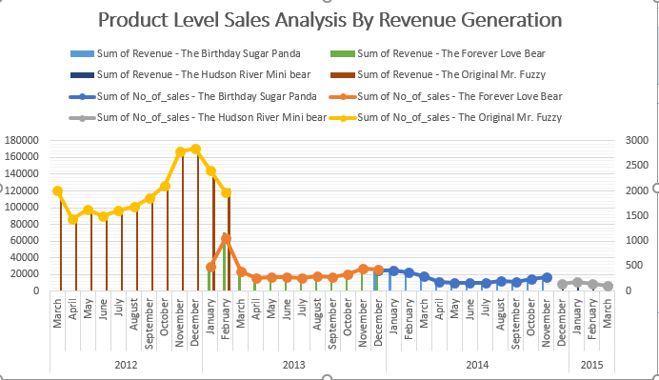
Data Exploration & Finding Insights
Product Level Sales Analysis-From this analysis we find lot of things like product 1 is the most old and revenue generated product for this company and if we clearly look on this chart we can observe for product 1 generates largest amount of revenue in winter season.
For Product 2 we can assume that product 2 maximum revenue comes from February(Valentine Month) month So we can target 18-30 age group audience for this product.
PRODUCT LEVEL SALES ANALYSIS BY REVENUE GENERATION

Slide 8
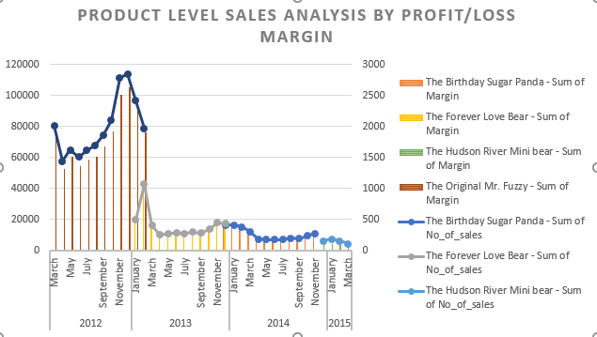
Data Exploration & Finding Insights
For Product 1 its profit is in decrease for the first 2 quarters then slowly increase profit percentage in last quarters, and for the product 2 profit jumps in first quarters then decrease more then 50% from its first quarter.
For Product 3 Profit margin is low compare to 1st product and 2nd product but for the product 3 case there is no huge change between profit and loss.
PRODUCT LEVEL SALES ANALYSIS BY PROFIT AND LOSS MARGIN
Place any supporting images, graphs, data or extra text here.

Slide 9
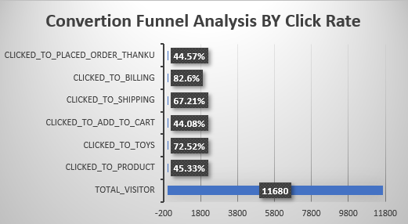
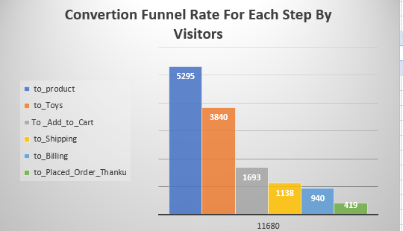
Data Exploration & Finding Insights
Conversion Rate Optimization is a marketing optimization process that follows a framework to increase the percentage of visitors who complete a website’s goal. Conversion optimization analyzes the behavior of visitors and focuses on what motivates a particular market segment to engage in a certain way with specific marketing elements. Average Conversion Rate Optimization is 4% of the total Visitors and here for this business average CRO is near about 4% so its standard CRO.And for the Ideal Click Through Rate Its range between 15%-20%,here we can see for each business step CTR is Standard.

Slide 10
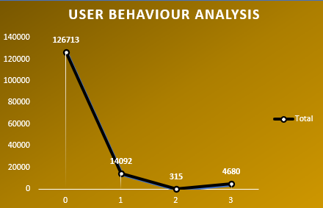
Data Exploration & Finding Insights
User Behaviour Analysis
First Repeat Visitor Ratio(RVR) =14092/126713 that means nearly 11.5 % is RVR ,For the Second RVR=315/14092 that means 2% RVR,And for the Third RVR=4680/315 nearly 13% RVR.So From this RVR Analysis we can determine business success rate to engage customers.
Place any supporting images, graphs, data or extra text here.

Slide 11
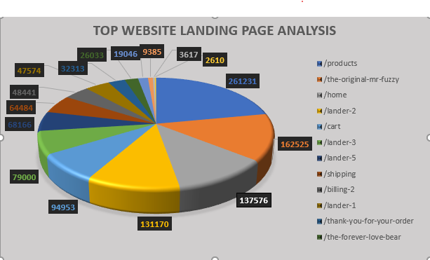
Data Exploration & Finding Insights
If a user is easily able to navigate your page and checkout without a second of confusion, that means more conversions for you. (If someone gets confused or frustrated with the cart on your website, for example, they may give up and go to Amazon where they’re likely familiar with the checkout page. Here comes landing page analysis, it gives better understanding to know which page is comfortable for customers, if landing page analysis is falls between 2.35% - 5.35% range then it consider ideal market standard .
Place any supporting images, graphs, data or extra text here.

Slide 12
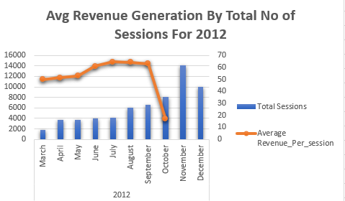
Data Exploration & Finding Insights
For the year 2012 we can clearly observe that avg revenue was good in first quarter and avg revenue increased in middle quarter but in last quarter avg revenue decreased heavily. So from this analysis we can assume that in winter season period sales were not up to the average mark. But for product order purpose it was high in winter season.

Slide 13
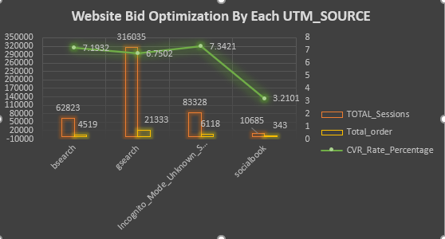
Data Exploration & Finding Insights
Website Bid Optimization is also well known insights to maintain budget for each paid advertisement, From this aspect we can make decision for business ,here in chart we can clearly notice that from google search is the most searchable search engine in terms of website visit sessions and also for order placed and 2nd highest is socialbook in terms of sessions and orders. So we can set bid higher for google search and socialbook. But if we look onto CVR Growth percentage incognito search engine is leading.

Slide 14
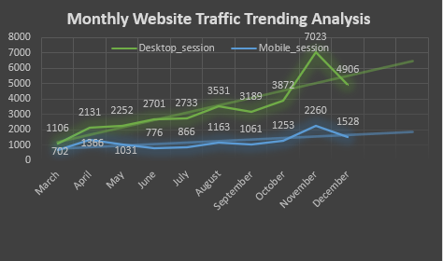
Data Exploration & Finding Insights
Website Traffic Trending Analysis-Here From these charts we can assume that larger amount of traffic comes from desktop source compare to mobile, So based on this particular insight business should more focus on mobile landing pages.From this analysis we can get Customer details,time spending,What they are doing while they are using websites,Most Likely Reasons they left website.

Slide 15
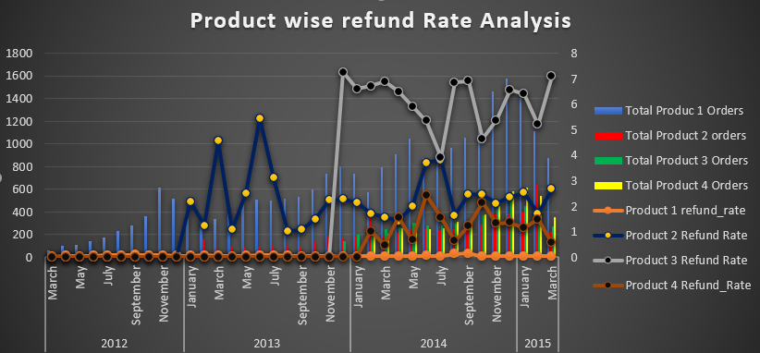
Data Exploration & Finding Insights
Product Refund Rate Analysis-Product Refund Analysis is one the most important aspects to observe, here among 4 products order vs refund rate, product 1 is most successful product as its order vs refund rate ratio is less whereas product 2 and 3 refund rate is very high compare to its order quantity, and product 4 is new product but its order vs refund rate is good compare to 2&3 So we can get clear insights from this analysis which product we should focus more and which product most loved by customers. Ideal Refund Rate Should be 20% of its order quantity

Slide 16
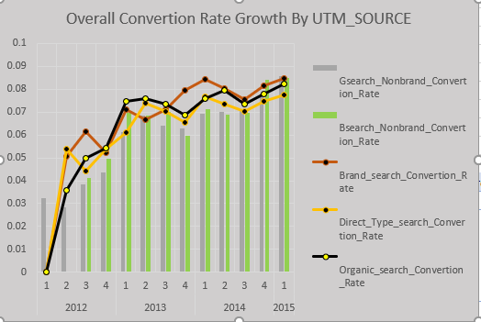
Data Exploration & Finding Insights
One of the biggest challenges marketers are facing is tracking conversions correctly. A proper conversion tracking leads to a better understanding of how each marketing channel, campaign or ad is performing, and how to allocate the marketing budget and efforts to maximize results. Google Search is the top most utm source by website session wise but for the conversion rate growth analysis Direct Search is the most consistent search engine used by customers. And if we take organic search it is lower then direct search, So Company should focus on their paid
Channels.

Slide 17
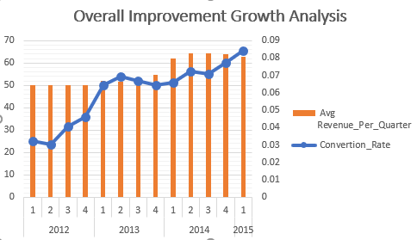
Data Exploration & Finding Insights
Revenue Growth Rate measures the month-over-month percentage increase in revenue. It’s one of the most common and important startup metrics. The Revenue Growth Rate provides a solid indicator of how quickly your startup is growing. If we look on to revenue metrics from chart 1 we can observe average revenue for each quarter is nearly 50000 USD .And for the Avg CVR Analysis in 2012 it was low and increased from last quarter 2012. In 2012 Total number of product 1 order is very high compare to product 2,for the first 3 quarters product 1 quantity was increased month by month. But at the end of the year product sales heavily decreased after September 2012. For product 2 it was not high as product 1 order rate in all quarters

Slide 18
Recommendations
From the above analysis here are some recommendations for online e-commerce portals
The most recent product is product 4 and from product 1 and 2 business got maximum revenue,product 3 & 4 has minimum revenue as per the manufacturing cost, So Company should focus and give more time on these two products.
Though Product 1 and 2 generated highest profit for the business but end of year 2013 company faced huge number of loss on the other side product 3 has not higher profit margin but it is the most steady performance,Sp based on this company will surely look on to product 1&2 and try to improve product 3 performance.
Average CRO and CTR is ideal but not well performed, So try to improve CRO Rate specially to convert more sessions into orders.
Maximum number of visitor came on website and made order from mobile while desktop performed better for conversion rate, based on this analysis we can clearly recommend to website managers to improve mobile friendly order page and modify desktop landing pages.
Based on RVR Analysis Company should focus on their customers Although there is no optimal standard laid out for the rate of returning visitors to your site, and RVR below 25% is not good. It mostly points to the ineffectiveness of website content in bringing back visitors to the site. It’s probably time to examine your website content and see if it needs some improvement. If you have an RVR of 30%, then it is good news, content is perceived as useful or entertaining to your visitors.

Slide 19
Recommendations
From the above analysis here are some recommendations for online e-commerce portals
To get more number repeat sessions company should also focus on some landing pages which are very low rate compare to others, from landing page analysis some of pages has very low rate,So try to improve those landing page design, modify content to increase repeat sessions.
For Bid Optimization analysis Google Search is the highest number of orders and sessions and social platforms has the highest conversion rate, So based on this company decrease their bids in G search and increase theier bidding on social platforms to get better performance.
Product 3 is the most unsatisfied product for the customers as it has maximum number of refund rate and product 1 is the most successful product for this company, So company improve product 3 quality to reduce refund rate.
If we know which marketing channels, campaigns, or ads are generating conversions, we can easily allocate our budget where it is actually paying off and get rid of ineffective marketing channels. So based on this analysis business can reallocate paid advertisement budget.

Slide 20
Thank You

